Slide 1
Family Day Care Home
Monitoring & Seriously Deficient Process

Slide 2
Monitoring Requirements

Slide 3
Monitoring Requirements
Why monitor?
Review providers’ home for compliance
Oversee staff monitoring visits (Quality Assurance Review)
Program compliance IAW USDA regulations
Monitoring Schedule – Per Year
2 Unannounced Visits
1 Announced Visit
Use Monitoring Required Form
5 - Day Reconciliation

Slide 4
Who’s monitoring the monitor?
Perfect Reviews??
No Reviews??
Phantom Reviews??
Perfunctory Reviews??

Slide 5
Monitoring Requirements
Sponsors shall…
Develop a monitoring evaluation system
Develop a preplanned monitoring schedule
Monitor each approved meal type
Effectively training monitors
Equip monitors with proper tools (i.e. current monitoring review forms)
Discuss review findings
Review forms for completeness & accuracy
Re-train if necessary

Slide 6
Monitoring Evaluation System
Shall include but not limited to:
Problems identified
Perfect reviews
Technical Assistance provided
Corrective Action(s) (CA) taken
Deadlines for CA noted
Signatures
Follow-up visits scheduled

Slide 7
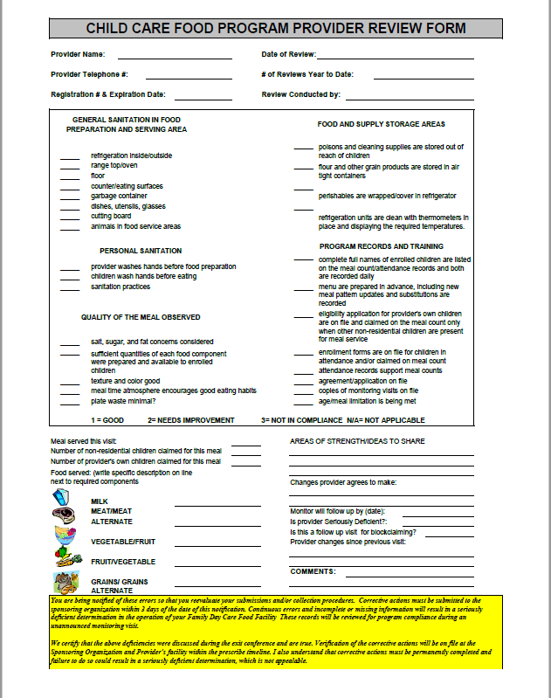
Monitoring Requirements
Things to consider
Are all the monitoring visits perfect, without any deficiencies?
Did the monitor observe a meal service?
Did the monitor use the required forms?
Pre-approval form
Child Care Food program Provider Review Form (a.k.a. short form)

Slide 8
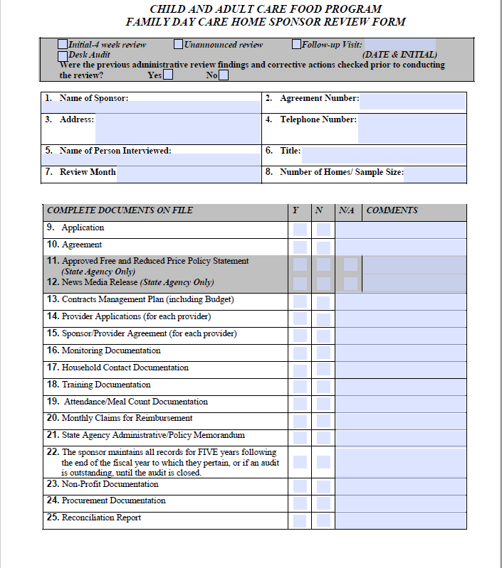
Monitoring Requirements
Family Day Care Home Review Form (a.k.a. long form) ***Must be used at least once per fiscal year***
Are monitoring visits no more than six months apart from one fiscal year to the other?
Is the Provider Call- In Policy used effectively?
Should the home be determined as Seriously Deficient for non-compliance

Slide 9
Full-Time Equivalent (FTE)
50 – 150 homes = 1 FTE

Slide 10
5-Day Reconciliation
Who’s required?
Day care home or sponsored center
What’s reviewed?
Comparison of enrollment, attendance, and meal counts – for a five-day period.
Why review?
Is a simple way for sponsoring organization monitors to look for consistency and determine that meal counts, and claims are reasonable.
Notes:
Reconciliation of meals counts is effective as a quick spot check to highlight red flags in claiming procedures, without requiring the collection of multiple sets of records.
Attendance serves as an edit check for meal counts. Enrollment serves as an edit check on attendance. The reconciliation works because meal counts can never exceed the number of children recorded in attendance at the day care home or center.

Slide 11
5-Day Reconciliation
List the meal count, attendance and enrollment/eligibility totals for the same meal type for the previous five (5) days.
Date | 4/10/20_ | 4/11/20_ | 4/12/20_ | 4/13/20_ | 4/14/20_
Meal Count | 2 | 2 | 3 | 4 | 2
Attendance | 2 | 2 | 3 | 4 | 2
Eligibility/ Enrollment | 4 | 4 | 4 | 4 | 3
Note, if there is evidence of block claiming , expand the reconciliation for an additional 10 days.

Slide 12
5-Day Reconciliation
Based on the 5-day reconciliation, if there is evidence of repetition, expand the reconciliation for an additional 10 days.
Date
Meal Count
Attendance
Eligibility/ Enrollment

Slide 13
Monitoring Requirements
What is household contact?
Contacts made by a sponsoring organization or a State agency to the participant’s home in order to verify the attendance and enrollment of the child and the specific meal service(s) which the child routinely receives while in care.
CACFP Household Contact Policy
Conduct annually or as necessary
Maintain responses on file
Household contact Surveys valid for one year

Slide 14
Preparing for your Administrative Review
1.) You will receive:
a) Administrative Review and Appointment Letter
b) Administrative Review Checklist
c) Administrative Pre-view Fact Sheet
2.) Prepare your institution (clean facility, post required documents, recordkeeping standards, etc.).
3.) Review CACFP Procedures (meal counts, daily attendance, CACFP contracts, etc.).

Slide 15
Preparing for your Administrative Review
Receive
1.) You will receive:
Administrative Review and Appointment Letter
Administrative Review Checklist
Administrative Pre-view Fact Sheet
Prepare
2.) Prepare your institution
(clean facility, post required documents, recordkeeping standards, etc.).
Review
3.) Review CACFP Procedures
(meal counts, daily attendance, CACFP contracts, etc.).

Slide 16
Some C.A. must be < 30 Days
Unlawful practices
False or fraudulent claims
False information on application
Concealed past performance problems

Slide 17
C.A. May Take Up to 90 Days
Training
Monitoring
Certain recordkeeping problems
Some performance standards problems

Slide 18
Some C.A. May Take Over 90 Days
Long-term changes to management systems or processes
Computer system changes
Certain personnel
However, Must have C.A. Plan
Within 90 days
Completion date and milestones for completing specific tasks

Slide 19
Corrective action plan (CAP)
Requirements of a CAP:
Detailed step-by-step actions
Actions must resolve the root-cause condition that resulted in the noncompliance
Actions must prevent recurrence
Process and procedures are consistent with federal regulations, State policy, and organization requirements

Slide 20
Corrective action plan (CAP)
Determine whether documented plan includes all required elements
Assess whether noncompliance is sufficiently addressed
Determine whether noncompliance is likely to recur
Assess whether corrective action has been fully implemented

Slide 21
Corrective Action Sample
Submit a written corrective action plan (CAP) explaining:
Who is/are responsible for implementing and complying with the process and/or procedures? (Name and Title)?
What process and/or procedures will be implemented to correct the findings? (Detail)?
When will the process and/or procedure be implemented? (Specific date)?
Where will the corrective action plan documentation be retained/ stored/ filed?
How often will this information be collected? How will the program ensure that the processes and/or procedures are followed consistently in order to prevent future findings? (Detail)

Slide 22
Temporary Hold for Non-Compliance
2 CFR 200.338
If a non-Federal entity fails to comply with Federal statutes, regulations or the terms and conditions of a Federal award, the Federal awarding agency or pass-through entity may impose additional conditions, as described in §200.207 Specific conditions. If the Federal awarding agency or pass-through entity determines that noncompliance cannot be remedied by imposing additional conditions, the Federal awarding agency or pass-through entity may take one or more of the following actions, as appropriate in the circumstances:
(a) Temporarily withhold cash payments pending correction of the deficiency by the non-Federal entity or more severe enforcement action by the Federal awarding agency or pass-through entity.
(b) Disallow (that is, deny both use of funds and any applicable matching credit for) all or part of the cost of the activity or action not in compliance.
(c) Wholly or partly suspend or terminate the Federal award.
(d) Initiate suspension or debarment proceedings as authorized under 2 CFR part 180 and Federal awarding agency regulations (or in the case of a pass-through entity, recommend such a proceeding be initiated by a Federal awarding agency).
(e) Withhold further Federal awards for the project or program.
(f) Take other remedies that may be legally available.

Slide 23
What is Serious Deficiency?
It is a process used by State agencies and sponsoring organizations to notify family day care home providers of serious and/or repeat issues regarding their CACFP operation.
It is a Federal regulation, and SO must utilize the SD process when there is evidence of serious and/or repeat issues of Program non-compliance.
All SD notices must be sent by certified mail, return receipt (or equivalent private delivery service), by fax, or by email (with proof of delivery).

Slide 24
Determining a Serious Deficiency
How does a SO decide if a serious deficiency is warranted?
What methods should a SO use to make that decision?
Is the deficiency detecting an isolated event or a systemic issue?

Slide 25
Sponsoring Organization and the Serious Deficiency Process
The SO has the authority to decide when a violation rises to the level of a serious deficiency.
This process
Brings attention to the serious deficiencies found in the FDCH provider’s CACFP operation;
Gives the FDCH provider the opportunity to correct the deficiencies noted;
Allows the SO the ability to terminate and disqualify a FDCH provider for continual non-compliance of CACFP regulations.

Slide 26
List of serious deficiencies
226.16(l)(2) lists the following serious deficiencies:
Submission of false information on the application
Submission of false claims for reimbursement;
Simultaneous participation under more than one organization
Non-compliance with Program meal pattern
Failure to keep required records
Failure to participate in training
Repeat findings

Slide 27
Six Steps in the Serious Deficiency Process
Identify the serious deficiencies (SD);
Issue a notice of serious deficiency (SD);
Receive and assess the institution’s written corrective action plan (CAP) for adequacy;
Issue a notice of temporary deferral of the serious deficiency if the CAP is approved, or issue a notice of proposed termination and disqualification, including appeal procedures, if the CAP is not adequate (or if no CAP plan is received);
Provide an appeal review (appeal hearing, administrative review), if requested, of the proposed termination and disqualification; and
Issue a notice of final termination and disqualification if the appeal is upheld or if the timeframe for requesting an appeal has passed or issue a notice of temporary deferral if the appeal is overturned.

Slide 28
What is a corrective action plan (CAP)?
Steps that must be taken by the family day care home provider in order to permanently correct the deficiencies found during the SO’s review of a FDCH’s CACFP operation.
These steps must
Be written,
Address each serious deficiency cited,
Be submitted no later than the due date.

Slide 29
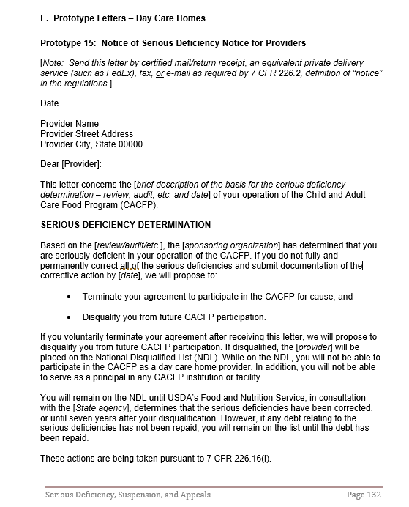
Notice of Serious Deficiency (NSD)
Contents of an NSD
Date of NSD
Name and address of FDCH Provider
SO’s determination of SD
- Deficiency detected and regulatory citation;
Corrective action required.
Additional information as required by regulations (Sample letter for NSD)
Date corrective action is due.

Slide 30
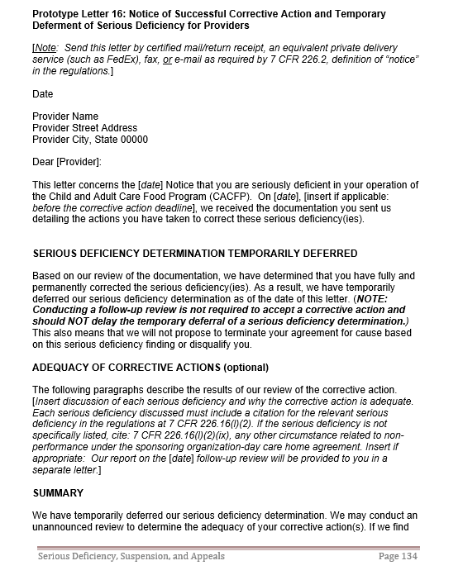
Notice of Temporary Deferral of Serious Deficiency (NTDSD)
The SO uses this notice to notify FDCHs that…
The corrective action plan submitted was received on time, reviewed by the SO, and was approved.
The Notice of Serious Deficiency is being temporarily deferred.

Slide 31
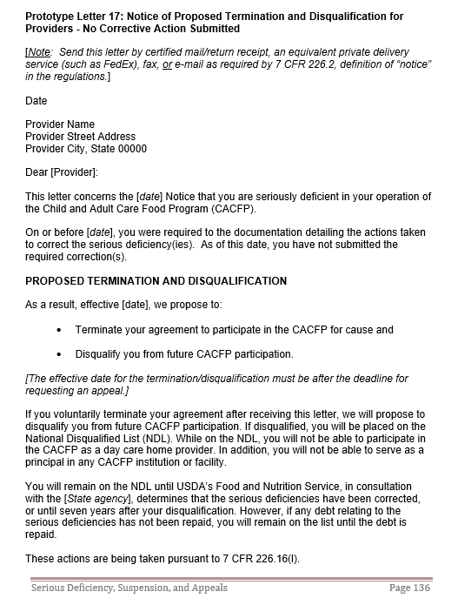
Notice of Proposed Termination/Disqualification (NPTD)
This is the next step in the SD process. This notice is used when
The corrective action was not submitted by the due date.
The corrective action submitted could not be approved.
A FDCH license has been “suspended” for imminent threat to the health and safety of the children.
There is positive proof that FDCH submitted false claim.

Slide 32
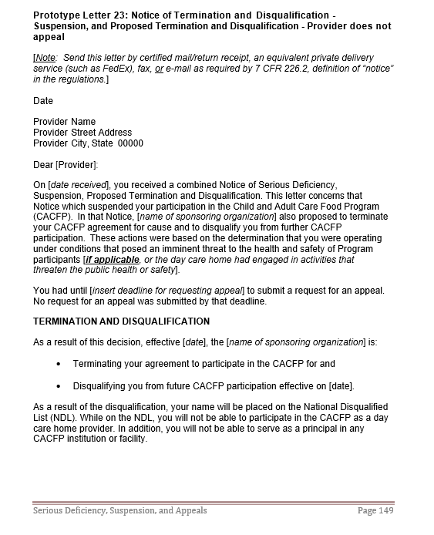
Notice of Final Termination and Disqualification (NFTD)
When the time to request an administrative appeal has expired and no appeal was submitted, the SO issues a notice of final termination and disqualification to the FDCH.
The notice must contain
Date
Name and address of FDCH
SO’s determination that CAP was never received OR
SO’s determination that CAP was not approved.
No appeal request was received.
Additional information required by regulations (Sample letter for NFTD)

Slide 33
Appeal Process
7CFR 226.6(l) Administrative reviews for day care homes
If a SO issues a Notice of Proposal to Terminate (NPTD) to a FDCH, appeal procedures must be given to the provider at the same time.
If the FDCH provider decides to appeal the NPTD, the request must be done according to the appeal procedures otherwise the appeal may be denied.
If a SO receives a timely appeal request from the FDCH, the SO must send the provider an acknowledgement of the appeal.
The appeal process must
Be applied consistently for all FDCHs
Allow the FDCH to have representation;
Provide the FDCH the opportunity to review all records regarding the NPTD;
Ensure the hearing official is impartial and can render a decision based solely on the information provided.

Slide 34
Appeal Decisions
Hearing official rules in favor of the FDCH
The SO will issue a letter to the FDCH stating that
The proposed termination and disqualification will not take place; however,
The serious deficiencies must still be corrected.
Failure to do so will result in another NPTD being issued with no further chance for corrective action.
Hearing official rules in favor of the SO
The SO will issue an NFTD effective the date of the hearing official’s decision.
The FDCH will be placed on the NDL.
Please know that the hearing official’s decision is final.

Slide 35
Thank you!

